Slide 1
Heart Disease
Analysis
Justin Sherwood
May 7th, 2024
CMP-262

Slide 2

Heart Disease history
Heart disease has had a profound impact on human health throughout history, evolving from ancient observations to modern-day medical breakthroughs.
Despite significant advancements in understanding, diagnosis, and treatment, it remains a leading cause of death globally.
The ongoing fight against heart disease emphasizes preventative measures, lifestyle changes, and innovative medical interventions.

Slide 3

Welcome!
An analysis of heart disease typically involves examining various risk factors, such as high blood pressure, high cholesterol levels, smoking, obesity, and lack of physical activity.
Today, we will provide data analysis using a dataset of ~300k patients. The analysis will include statistical analysis, and visualizations to show how risk factors impact the prevalence of heart disease.
Justin Sherwood
Data Analyst
Work full time at Novartis Pharmaceuticals as a data analyst.

Slide 4





Methodology
Dataset
Tools
Kaggle – Heart Disease
Format - CSV
Anaconda – Jupyter Notebook
various python modules.
Time!
Data Characteristics
Patient demographic information
Lifestyle factors
Clinical measurements

Slide 5
Analysis Goals
What is the correlation between BMI and the likelihood of having heart disease?
How does smoking impact the prevalence of heart disease among different age groups?
Is there a significant difference in the occurrence of heart disease between males and females?
What is the association between alcohol consumption and the incidence of heart disease?
Are there any notable disparities in heart disease rates among different racial groups?

Slide 6
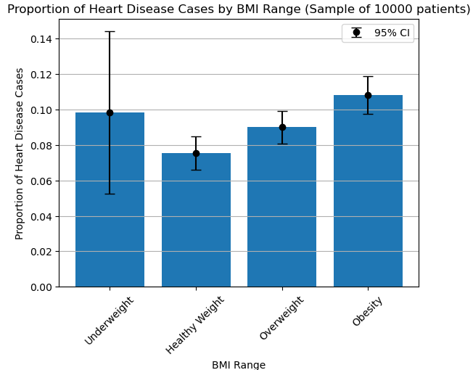
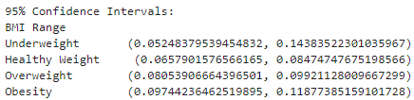
Question 1
What is the correlation between BMI and the likelihood of having heart disease?
Statistical Analysis
Insights
analysis reflects a trend of increasing proportions of Heart Disease cases from healthy weight to overweight and obesity categories.
Confidence intervals provide insights into the precision of these estimates, with narrower intervals indicating higher confidence in the proportions
Notes:
Class analysis Underweight - The proportion of Heart Disease cases among underweight individuals is approximately 9.8%, with a wide confidence interval indicating some uncertainty due to the smaller sample size.
Healthy Weight - Individuals with a normal BMI, the proportion of Heart Disease cases is approximately 7.5%, with a relatively narrow confidence interval suggesting higher confidence in this estimate
Overweight - The proportion of Heart Disease cases among overweight individuals is around 9.0%, with a moderate confidence interval suggesting some variability in the estimate.
Obesity - In the obesity category, the proportion of Heart Disease cases is approximately 10.8%, with a confidence interval indicating moderate precision in the estimate.

Slide 7
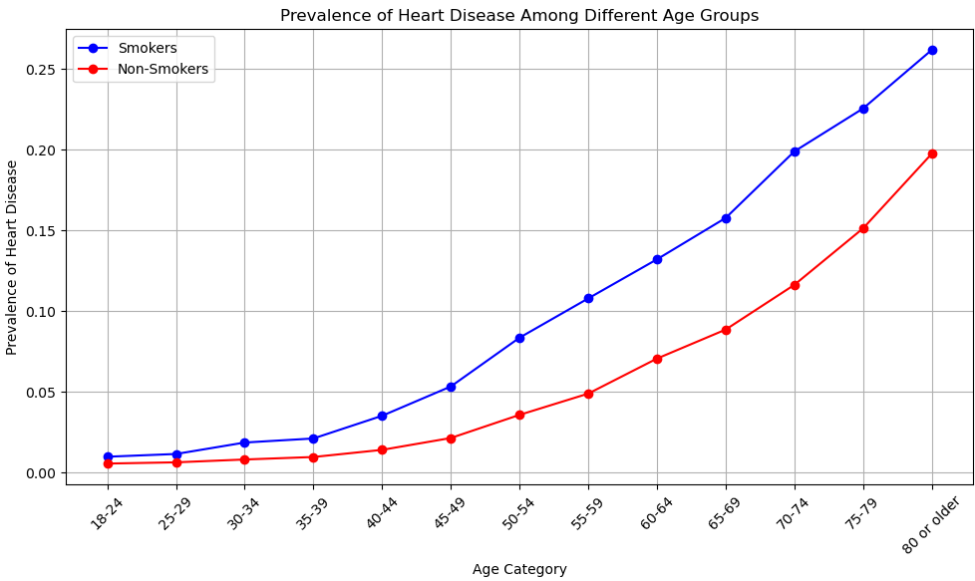
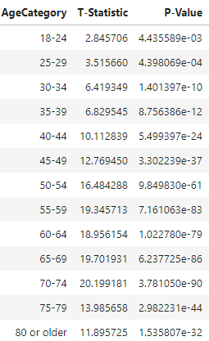
Question 2
How does smoking impact the prevalence of heart disease among different age groups?
Statistical Analysis
The analysis suggested that there are significant differences between the age categories being measured, and the count of patients with heart disease increased as individuals move into older age groups. The findings reinforce the well-established link between smoking and cardiovascular disease.
Notes:
There is a statistically significant difference in heart disease between smokers and non-smokers across all age categories. This finding is significant given the low p-values (< 0.05) for each age group, suggesting strong evidence against the null hypothesis.
The T-Statistic values increase as the age categories progress, indicating that the differences between adjacent age groups become more pronounced as people get older.
The P-Values are extremely small across all age categories, indicating strong evidence against the null hypothesis of no difference between age groups

Slide 8
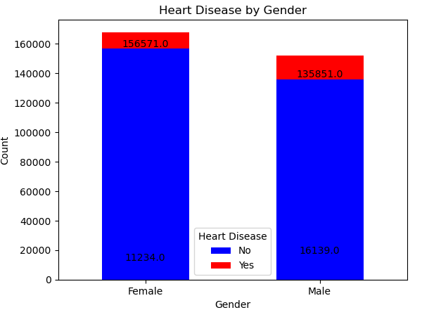
Question 3
Is there a significant difference in the occurrence of heart disease between males and females?
Statistical Analysis
Insights
the chi-squared test statistic is 1568.31, which is quite large. This suggests a substantial difference between the observed counts and what would be expected if there were no relationship between gender and heart disease.
The p-value associated with the chi-squared test is 0.0. we reject the null hypothesis (the hypothesis that there is no association between gender and heart disease)
Notes:
A chi-squared test is a statistical method used to determine whether there is a significant association between two categorical variables

Slide 9
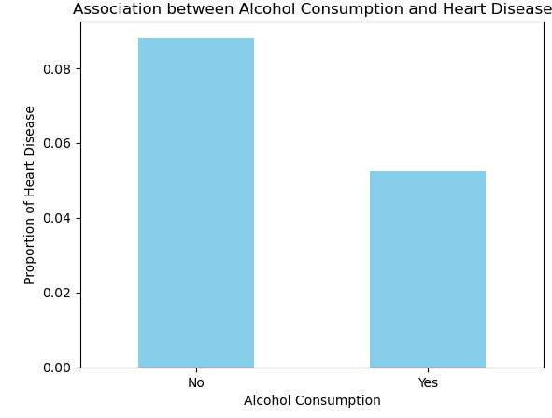
Question 4
What is the association between alcohol consumption and the incidence of heart disease?
Statistical Analysis
Insights
The chi-squared test statistic is 328.649. This value indicates the magnitude of difference between the observed frequency distribution of heart disease among different alcohol consumption.
The p-value associated is approximately 1.89e-73, which is extremely small. This indicates strong evidence against the null hypothesis, which assumes no association between alcohol consumption and heart disease
Notes:
A chi-squared test is a statistical method used to determine whether there is a significant association between two categorical variables
A higher chi-squared test statistic suggests a stronger association

Slide 10
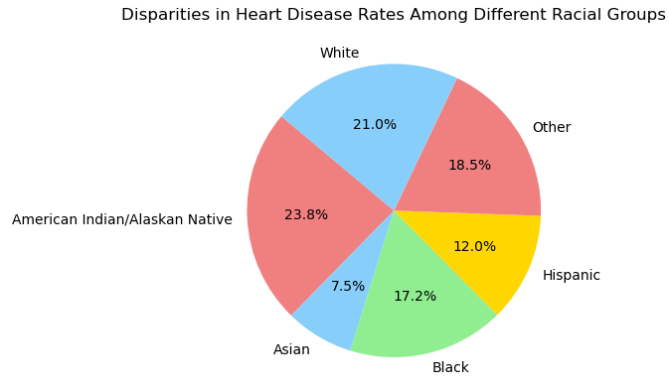
Question 5
Are there any notable disparities in heart disease rates among different racial groups?
Statistical Analysis
Insights
With an F-statistic of approximately 169.31 and an extremely small p-value −180, we have strong evidence to reject the null hypothesis. This indicates that there are notable disparities in heart disease rates among different racial groups.
Using the visual representation and the statistical test results, we can confidently conclude that there are significant disparities in heart disease rates across the racial groups included in the analysis.
Notes:
Performed a one-way ANOVA test

Slide 11
Client Recommendations
By examining the correlation between various risk factors and heart disease, the client can identify demographic groups or individuals with a higher risk of developing heart disease. This information can help target preventive interventions more effectively.
By examining lifestyle factors such as smoking, alcohol consumption, and demographics influence heart disease risk allows the client to develop targeted intervention strategies
Hospitals can use the findings as a basis for further investigation into the mechanisms underlying heart disease development and potential avenues for treatment or prevention.

